Slide 1
Introduction to Computer Graphics with WebGL
Ed Angel
Professor Emeritus of Computer Science
Founding Director, Arts, Research, Technology and Science Laboratory
University of New Mexico
Angel and Shreiner: Interactive Computer Graphics 7E © Addison-Wesley 2015

Slide 2
Lighting and Shading in WebGL
Ed Angel
Professor Emeritus of Computer Science
University of New Mexico
Angel and Shreiner: Interactive Computer Graphics 7E © Addison-Wesley 2015

Slide 3
Objectives
Introduce the WebGL shading methods
  Light and material functions on MV.js
  per vertex vs per fragment shading
  Where to carry out
Angel and Shreiner: Interactive Computer Graphics 7E © Addison-Wesley 2015

Slide 4
WebGL lighting
Need
  Normals
  Material properties
  Lights
State-based shading functions have been deprecated (glNormal, glMaterial, glLight)
Compute in application or in shaders
Angel and Shreiner: Interactive Computer Graphics 7E © Addison-Wesley 2015

Slide 5
Normalization
Cosine terms in lighting calculations can be computed using dot product
Unit length vectors simplify calculation
Usually we want to set the magnitudes to have unit length but
  Length can be affected by transformations
  Note that scaling does not preserved length
GLSL has a normalization function
Angel and Shreiner: Interactive Computer Graphics 7E © Addison-Wesley 2015

Slide 6
Normal for Triangle
n
plane n ·(p - p₀ ) = 0
p₂
n = (p₂ - p₀ ) ×(p₁ - p₀ )
p
p₁
normalize n ← n/ |n|
p₀
Note that right-hand rule determines outward face
Angel and Shreiner: Interactive Computer Graphics 7E © Addison-Wesley 2015

Slide 7
Specifying a Point Light Source
For each light source, we can set an RGBA for the diffuse, specular, and ambient components, and for the position
var diffuse0 = vec4(1.0, 0.0, 0.0, 1.0);
var ambient0 = vec4(1.0, 0.0, 0.0, 1.0);
var specular0 = vec4(1.0, 0.0, 0.0, 1.0);
var light0_pos = vec4(1.0, 2.0, 3,0, 1.0);
Angel and Shreiner: Interactive Computer Graphics 7E © Addison-Wesley 2015

Slide 8
Distance and Direction
The source colors are specified in RGBA
The position is given in homogeneous coordinates
  If w =1.0, we are specifying a finite location
  If w =0.0, we are specifying a parallel source with the given direction vector
The coefficients in distance terms are usually quadratic (1/(a+b*d+c*d*d)) where d is the distance from the point being rendered to the light source
Angel and Shreiner: Interactive Computer Graphics 7E © Addison-Wesley 2015

Slide 9
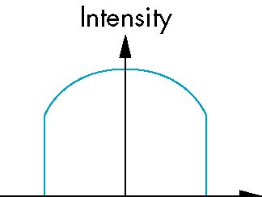
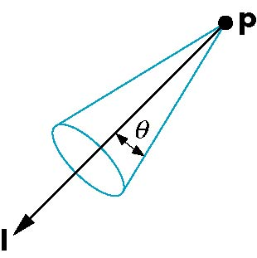
Spotlights
Derive from point source
  Direction
  Cutoff
  Attenuation Proportional to cos^{α}φ
−θ
φ
θ
Angel and Shreiner: Interactive Computer Graphics 7E © Addison-Wesley 2015

Slide 10
Global Ambient Light
Ambient light depends on color of light sources
  A red light in a white room will cause a red ambient term that disappears when the light is turned off
A global ambient term that is often helpful for testing
Angel and Shreiner: Interactive Computer Graphics 7E © Addison-Wesley 2015

Slide 11
Moving Light Sources
Light sources are geometric objects whose positions or directions are affected by the model-view matrix
Depending on where we place the position (direction) setting function, we can
  Move the light source(s) with the object(s)
  Fix the object(s) and move the light source(s)
  Fix the light source(s) and move the object(s)
  Move the light source(s) and object(s) independently
Angel and Shreiner: Interactive Computer Graphics 7E © Addison-Wesley 2015

Slide 12

Light Properties
var lightPosition = vec4(1.0, 1.0, 1.0, 0.0 );
var lightAmbient = vec4(0.2, 0.2, 0.2, 1.0 );
var lightDiffuse = vec4( 1.0, 1.0, 1.0, 1.0 );
var lightSpecular = vec4( 1.0, 1.0, 1.0, 1.0 );
Angel and Shreiner: Interactive Computer Graphics 7E © Addison-Wesley 2015

Slide 13
Material Properties
Material properties should match the terms in the light model
Reflectivities
w component gives opacity
var materialAmbient = vec4( 1.0, 0.0, 1.0, 1.0 );
var materialDiffuse = vec4( 1.0, 0.8, 0.0, 1.0);
var materialSpecular = vec4( 1.0, 0.8, 0.0, 1.0 );
var materialShininess = 100.0;
Angel and Shreiner: Interactive Computer Graphics 7E © Addison-Wesley 2015

Slide 14
Using MV.js for Products
var ambientProduct = mult(lightAmbient, materialAmbient);
var diffuseProduct = mult(lightDiffuse, materialDiffuse);
var specularProduct = mult(lightSpecular, materialSpecular);
gl.uniform4fv(gl.getUniformLocation(program,
"ambientProduct"), flatten(ambientProduct));
gl.uniform4fv(gl.getUniformLocation(program,
"diffuseProduct"), flatten(diffuseProduct) );
gl.uniform4fv(gl.getUniformLocation(program,
"specularProduct"), flatten(specularProduct) );
gl.uniform4fv(gl.getUniformLocation(program,
"lightPosition"), flatten(lightPosition) );
gl.uniform1f(gl.getUniformLocation(program,
"shininess"),materialShininess);
Angel and Shreiner: Interactive Computer Graphics 7E © Addison-Wesley 2015

Slide 15
Adding Normals for Quads
function quad(a, b, c, d) {
var t1 = subtract(vertices[b], vertices[a]);
var t2 = subtract(vertices[c], vertices[b]);
var normal = cross(t1, t2);
var normal = vec3(normal);
normal = normalize(normal);
pointsArray.push(vertices[a]);
normalsArray.push(normal);
.
.
.
Angel and Shreiner: Interactive Computer Graphics 7E © Addison-Wesley 2015

Slide 16
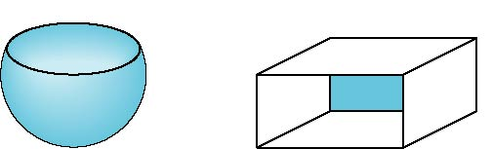

Front and Back Faces
Every face has a front and back
For many objects, we never see the back face so we don’t care how or if it’s rendered
If it matters, we can handle in shader
back faces not visible
back faces visible
Angel and Shreiner: Interactive Computer Graphics 7E © Addison-Wesley 2015

Slide 17
Emissive Term
We can simulate a light source in WebGL by giving a material an emissive component
This component is unaffected by any sources or transformations
Angel and Shreiner: Interactive Computer Graphics 7E © Addison-Wesley 2015

Slide 18
Transparency
Material properties are specified as RGBA values
The A value can be used to make the surface translucent
The default is that all surfaces are opaque
Later we will enable blending and use this feature
However with the HTML5 canvas, A<1 will mute colors
Angel and Shreiner: Interactive Computer Graphics 7E © Addison-Wesley 2015

